Slide 1

International Institute Of Information Technology
Department of Information Technology
Seminar Presentation
On
“Machine Learing”
“ Machine Learning”
Guide
“Monali Bansode”

Slide 2
Seminar Group
Seminar Motivation
Introduction
Literature Survey
Algorithm/Methodology Used
Application/s
Conclusion/s
References
CONTENTS

Slide 3
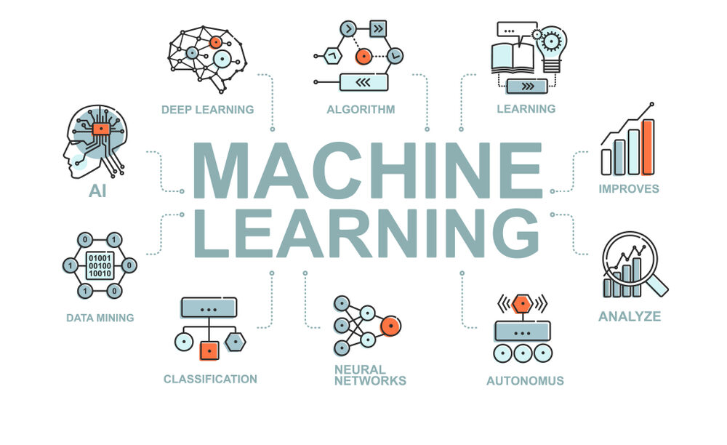
Seminar Details
Domain: Machine Learning

Slide 4
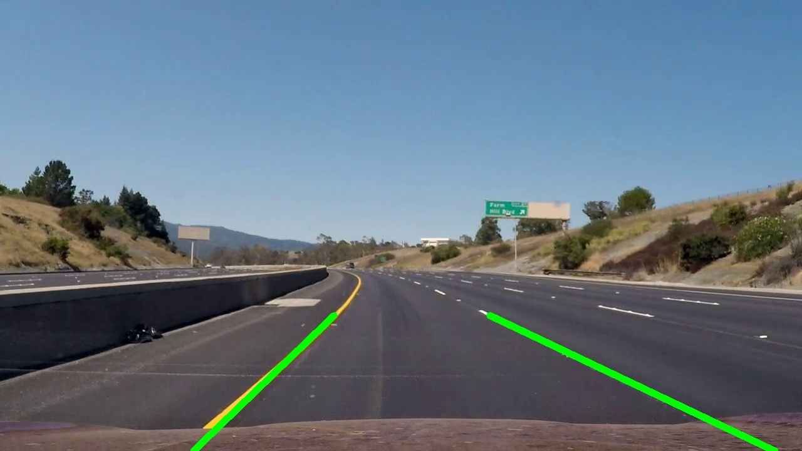
Seminar Details
Title : Road Lane Detection System
Domain : Machine Learning
By
Navnit A

Slide 6
Motivation
The motivation behind the development and implementation of lane search is based on a deep commitment to improving road safety and transforming the future of transportation. There are several important factors that led to the need for this work:
Improving Road Safety: Road accidents, including take-off-related accidents, continue to be a major concern worldwide. Most accidents occur when drivers unintentionally leave the designated lane.
The lane detection system aims to prevent such incidents by providing real-time lane guidance and warnings to drivers.

Slide 7
Problem Statement
"Develop an road lane detection system that can operate effectively under diverse and challenging real-world conditions."
The ultimate goal is to enhance road safety, assist human drivers, and contribute to the development of fully autonomous vehicles, promoting a safer, more efficient, and sustainable future for transportation

Slide 8

Aim and objectives
AIM: The purpose of lane searching is to improve road safety, support advanced driver assistance (ADAS)and contribute to the development and use of driving technology.The main goal is to provide timely and accurate information about lane locations and signs to help drivers make informed decisions and keep vehicles safe on the road. OBJECTIVES: (1)Effective traffic management: Contribute to traffic management by monitoring lanes, roads and traffic congestion to promote better traffic planning and reduce congestion. (2)Environmental impact: Promote responsible driving, thus saving fuel and reducing accidents. Emissions are based on sustainable development goals.

Slide 9
Introduction
Lane detection is a technique that uses computer vision, machine learning, and real-time data processing to identify and determine the path in the vehicle's field of view. This technology is welcomed for its ability to improve road safety, assist driving, and enhance advanced driver assistance systems (ADAS).
Roadmap is a technological solution designed to search and visualize images from embedded images or videos. The main aim is to help drivers make informed decisions and provide reliable and up-to-date information about lines, signs and boundaries to make driving easier.

Slide 10
(1)The main products and functions of the line calling system include: usually from the built-in camera.
(2)These cameras capture road conditions and provide the necessary information for lane detection.

Slide 11
Literature Survey
S.N. | Title of Paper | Work Description | Author Names | Problems Found
1 | Road Lane-Lines Detection in Real-Time for Advanced Driving Assistance Systems | In this paper, a fast and reliable lane-lines detection and tracking technique is developed, presented thoroughly and given the name “LaneRTD”. LaneRTD uses a pipeline of well known algorithms like Canny edge detection and Hough transform. Moreover, the pipeline uses a comprehensive lane line detection and drawing technique to produce the final output. | Wael Farag and Zakaria Saleh | Performance Accuracy: One problem could be the accuracy of lane detection, especially in challenging conditions like poor lighting, adverse weather, or complex road layouts. Possible solutions may involve using more advanced computer vision techniques, integrating other sensors (such as LiDAR or radar), or refining algorithms for improved accuracy.
2 | Vision Based Road Lane Detection System for Vehicles Guidance | A real time vision-based lane detection method was proposed. Image segmentation and remove the shadow of the road were processed. Canny operator was used to detect edges that represent road lanes or road boundaries. A hyperbola-pair road model used to deal with the occlusion and imperfect road condition. | Othman O Khalifa, Md. Rafiqul Islam, Abdulhakam.AM. Assidi, Aisha-Hassan Abdullah and Sheroz Khan | Real-time processing is often crucial for applications in Advanced Driver Assistance Systems (ADAS). If the system's performance doesn't meet real-time requirements, it could be a problem. Solutions may involve optimizing algorithms, using specialized hardware, or parallel processing.
3 | Computer Vision and Image Processing:A Paper Review | Computer vision has been related to image processing and machine learning. Computer vision as a field of a wide array of discipline has been linked closely to image processing discipline | Victor Wiley and Thomas Lucas | Ensuring the safety of ADAS is critical. Problems might arise in terms of redundancy and safety measures.
4 | Computer Vision An Overview For Enthusiasts | Computer vision systems have become so high-performing, that comparisons to human performance have been made. | C. Rasche | The ability to generalize lane detection across different environments and locations is essential.

Slide 12
Applications of Road lane Detection System
Autonomous Vehicles:
Lane detection is a fundamental component of self-driving cars. It enables autonomous vehicles to understand their position on the road, identify lanes, and make decisions based on lane markings.
Traffic Sign Recognition:
Road lane detection can be combined with traffic sign recognition to enhance driver assistance systems. This helps vehicles recognize speed limits, stop signs, and other road signs for improved safety.
Lane-Centered Navigation:
Lane detection is essential for lane-centered navigation systems, especially in complex urban environments. It assists drivers in navigating through complex intersections and highways.

Slide 13
Conclusion
In short, this project is an important step in the development of technology related to autonomous driving and advanced driver support. It takes photos of the road, processes them and creates a video output that clearly and visually displays the road lines. The process of this study includes basic steps such as edge detection, region of interest masking, Hough line detection and line extrapolation. Programming code as the basis for lane finding in autonomous vehicles and helping them understand and navigate the road by: Detecting and following lane markings. The ability to accurately identify and see lane markings is essential for steering control, lane keeping, and many other safety features in modern vehicles.This project demonstrates the ability of computer vision and image processing technology to extract valuable information from visual data, helping to improve safety and better transportation. Lane detection is just one part of a larger area of research aimed at making driving more realistic and improving driver safety

Slide 14
References
[1] Road Lane-Lines Detection in Real-Time for Advanced Driving Assistance Systems Conference: 2018 International Conference on Innovation and Intelligence for Informatics, Computing, and Technologies (3ICT)
[2] Computer Vision and Image Processing: A Paper Review International Journal Of Artificial Intelligence Research Vol 2, No 1, June 2018, pp. 28-36
[3] Vision Based Road Lane Detection System for Vehicles Guidance Australian Journal of Basic and Applied Sciences, 5(5): 728-738, 2011
[4] Computer Vision An Overview For Enthusiasts C. Rasche May 11, 2022

Slide 15
Thank you !!!

